Slide 1
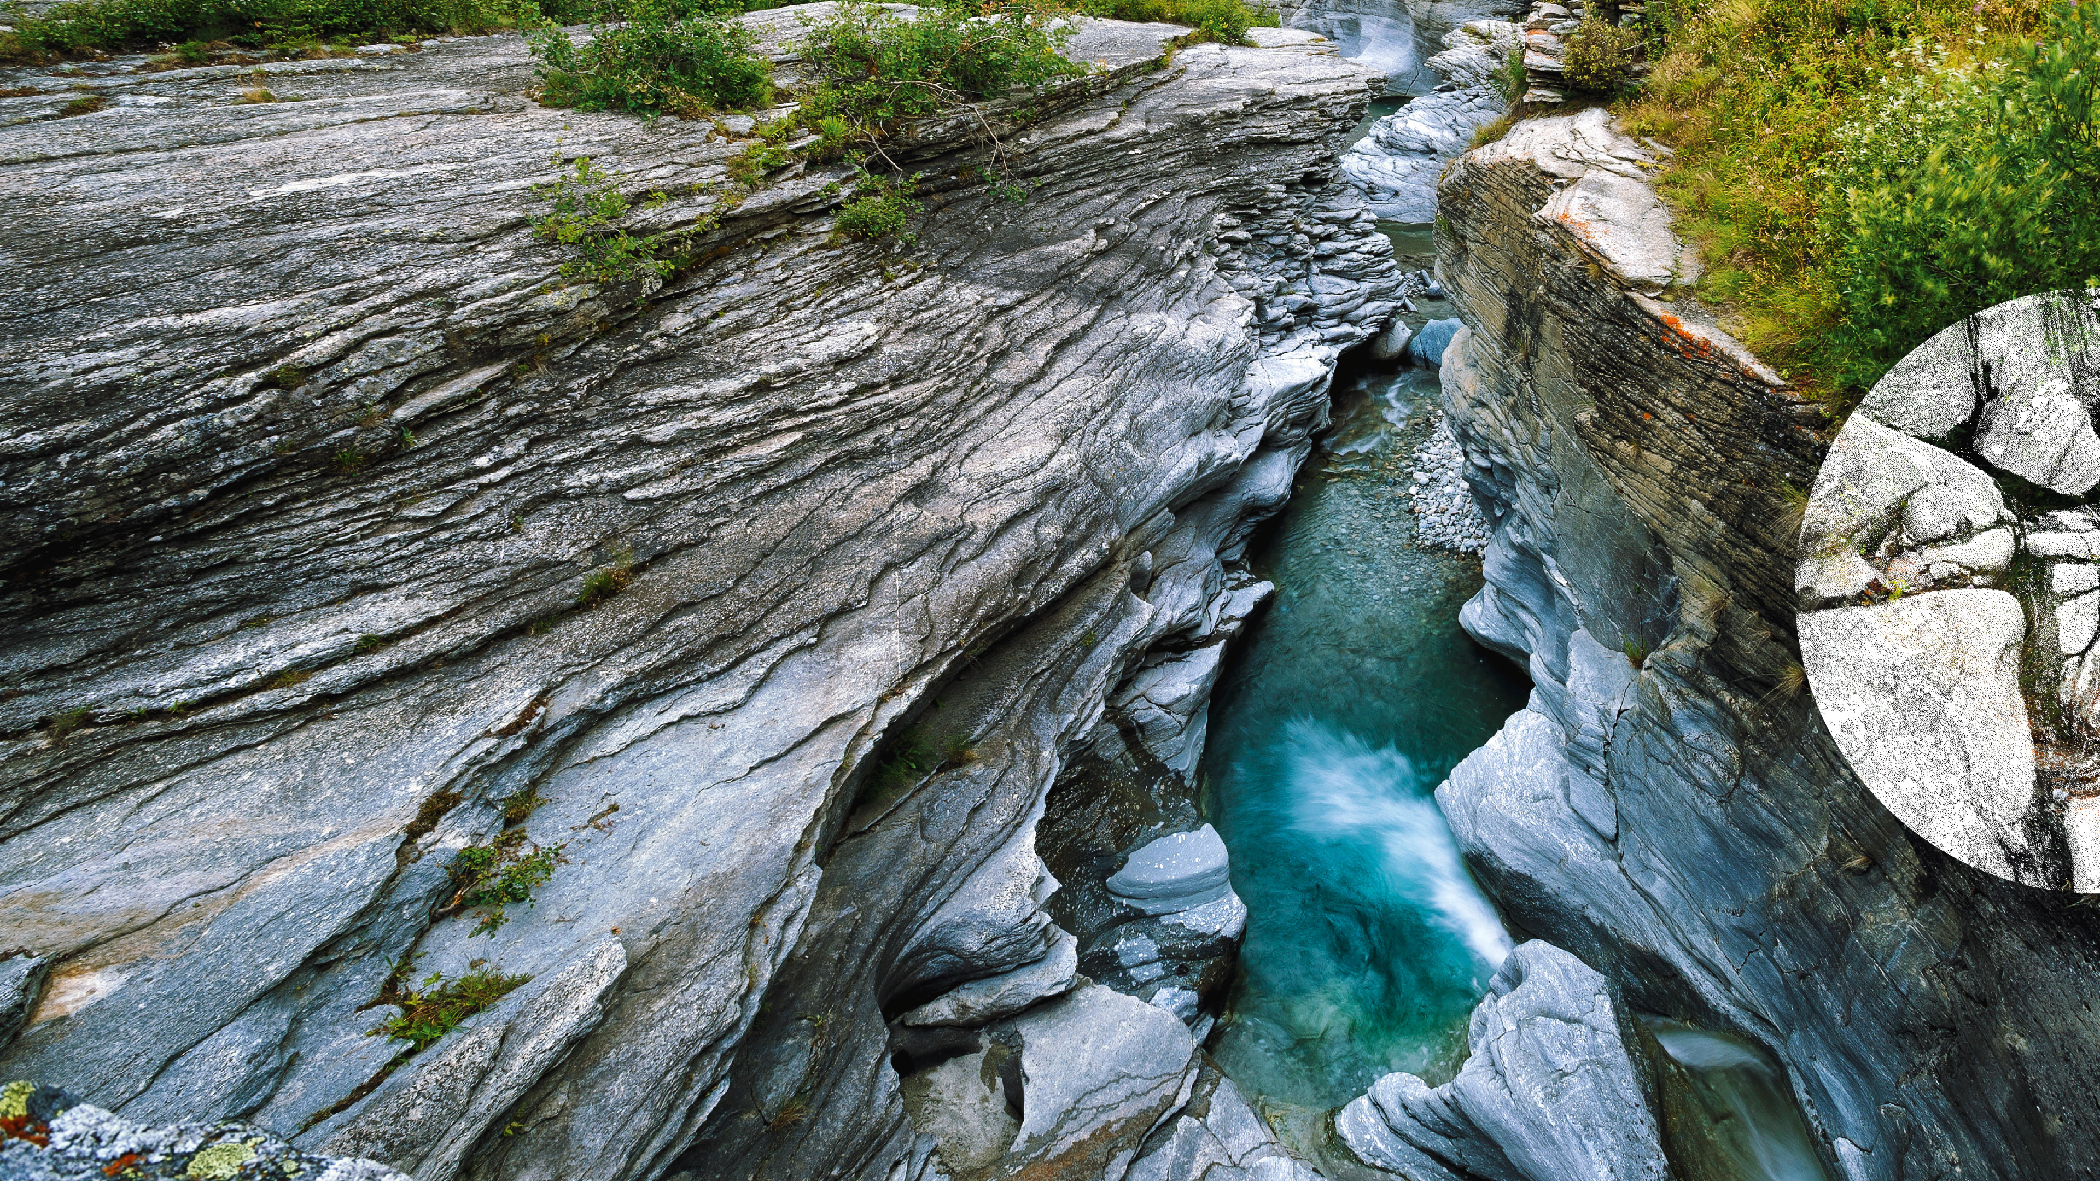

BRGM – INSIDE Use CasE & Expectations
04/10/2022

Slide 2
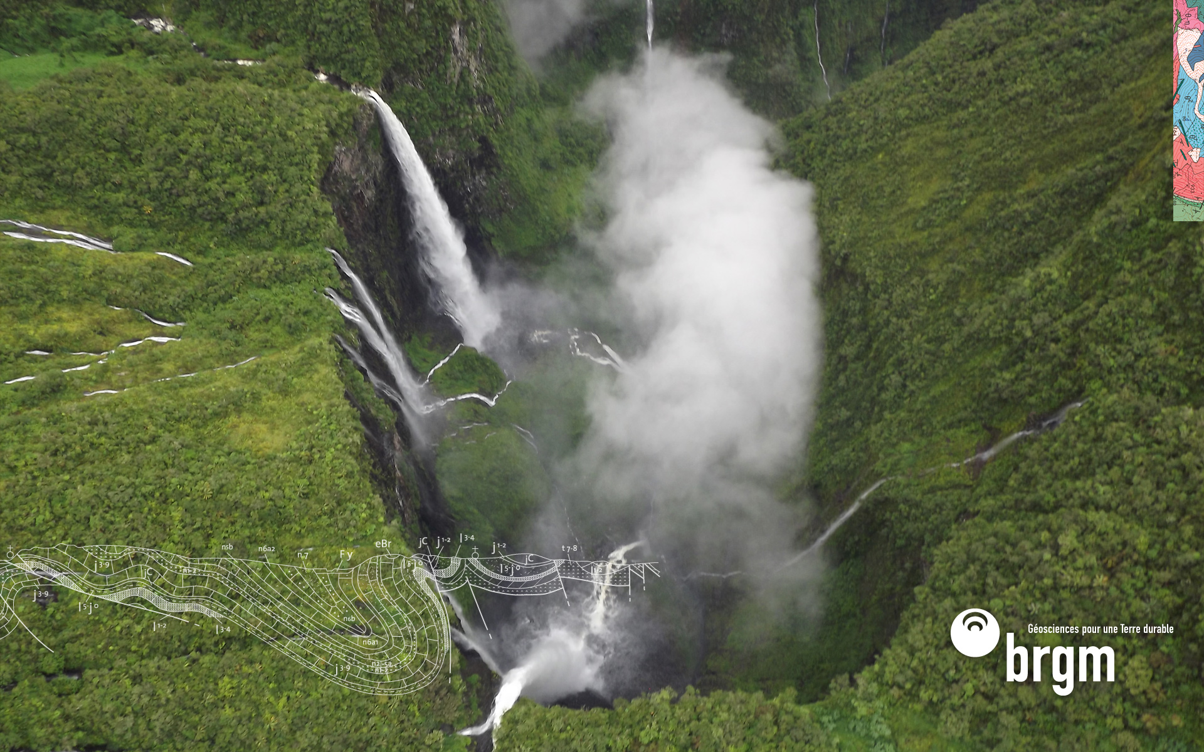
A vision - semantics
Ex : On surface water quality data base (chemical concentrations)* 130 million analysis result – complete model
River
samples
Water quality station
Sampling act
Sample
Water quality sampling point
Analysis
Environmental conditions (related obs)
Sub-sample
Result…
Analysis
Result…
Analysis
* Vision is the same for GroundWater Quality
Analysis
Analysis
Result…

Slide 3
A vision - semantics
Simplified (implemented) model => mapped to O&M and existing standards
River
sampledFeature
relatedSamplingFeature
fOi
relatedObservation
Water quality station
Water
Sample
Analysis
relatedObservation
fOi
Result…
relatedObservation
relatedObservation
Analysis
Environmental conditions (related obs)
Result…
Observation
Observation result
Water Sample (SF_Specimen)
River (ultimate fOI) : HY_Features
Other fOIs on the side (ex : river pertains to river basin) : HY_Features
OMS Observer VS INSPIRE Environmental Monitoring Facility (EF)
OMS Observer / INSPIRE:EF associated information
Analysis
Analysis

Slide 4
A vision - LinkedData
LinkedData as much as possible : URIs on FeatureInstance (and ?ObservationCollection / Observation?) AND controlled vocabularies (obs method, obs prop, …)
URI
River
sampledFeature
URI
relatedSamplingFeature
fOi
relatedObservation
Water quality station
Water
Sample
Analysis
URI
relatedObservation
fOi
Result…
relatedObservation
relatedObservation
Analysis
Environmental conditions (related obs)
Result…
Observation
Observation result
Water Sample (SF_Specimen)
River (ultimate fOI) : HY_Features
Other fOIs on the side (ex : river pertains to river basin) : HY_Features
OMS Observer VS INSPIRE Environmental Monitoring Facility (EF)
OMS Observer / INSPIRE:EF associated information
Analysis
Analysis

Slide 5
A vision – OGC APIs
Simplified (implemented) model => mapped to OGC API + ST API (other not done because of time)
API - Features
River
API - Features
sampledFeature
ST API
relatedSamplingFeature
fOi
relatedObservation
Water quality station
Water
Sample
Analysis
fOi
ST API
relatedObservation
Result…
API - Features
ST API
relatedObservation
relatedObservation
Analysis
Environmental conditions (related obs)
Result…
ST API
Observation
Observation result
Water Sample (SF_Specimen)
River (ultimate fOI) : HY_Features
Other fOIs on the side (ex : river pertains to river basin) : HY_Features
OMS Observer VS INSPIRE Environmental Monitoring Facility (EF)
OMS Observer / INSPIRE:EF associated information
OGC API - Features
Analysis
Analysis
OGC SensorThings API

Slide 6
A vision – observation API
Simplified (implemented) model => mapped to O&M and existing standards then ST API
River
fOI
sampledFeature
relatedSamplingFeature
fOi
relatedObservation
Water quality station
Water
Sample
Analysis
fOi
Obs
Thing
relatedObservation
Result…
relatedObservation
relatedObservation
Analysis
Environmental conditions (related obs)
Result…
Obs
Observation
Observation result
Water Sample (SF_Specimen)
River (ultimate fOI) : HY_Features
Other fOIs on the side (ex : river pertains to river basin) : HY_Features
OMS Observer VS INSPIRE Environmental Monitoring Facility (EF)
OMS Observer / INSPIRE:EF associated information
SensorThings API classes
Analysis
Analysis

Slide 7
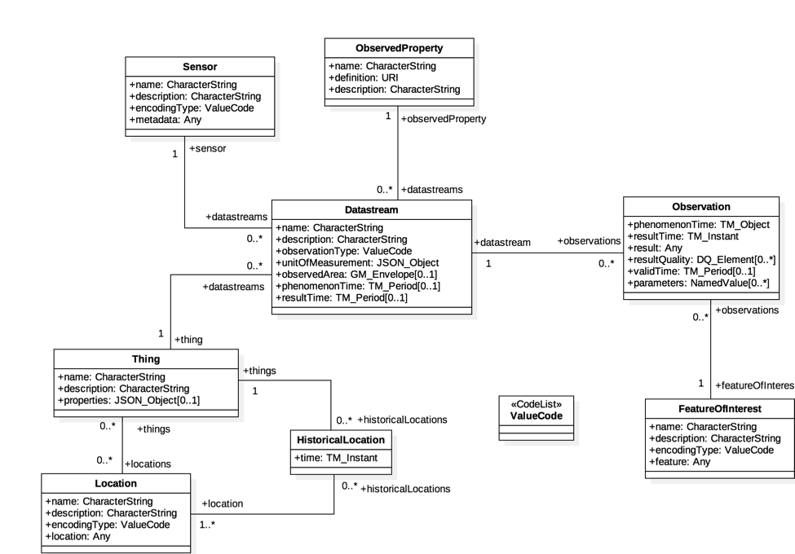
A vision – observation API
Chemical concentration - Simplified (implemented) model => mapped to ST API
Observed property
Analysis procedure
Observation on Sample
om:parameter :
fraction, medium
Monitoring
Facility
River
Water Sample
Analysis

Slide 8
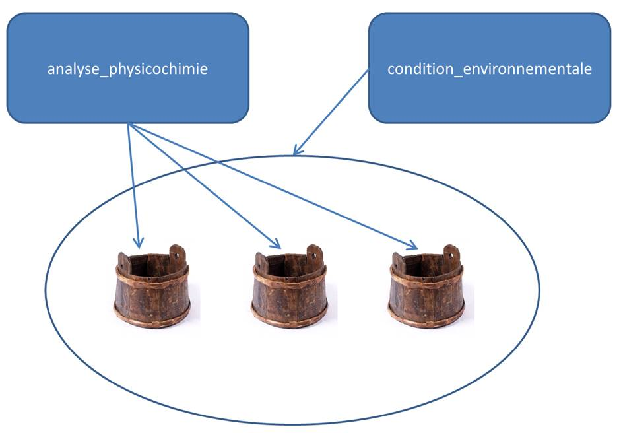
A vision – some more details
Introducing environmental conditions (ex : weather when sampling, …)
Water Sample
Environmental conditions when sampling
Analysis

Slide 9
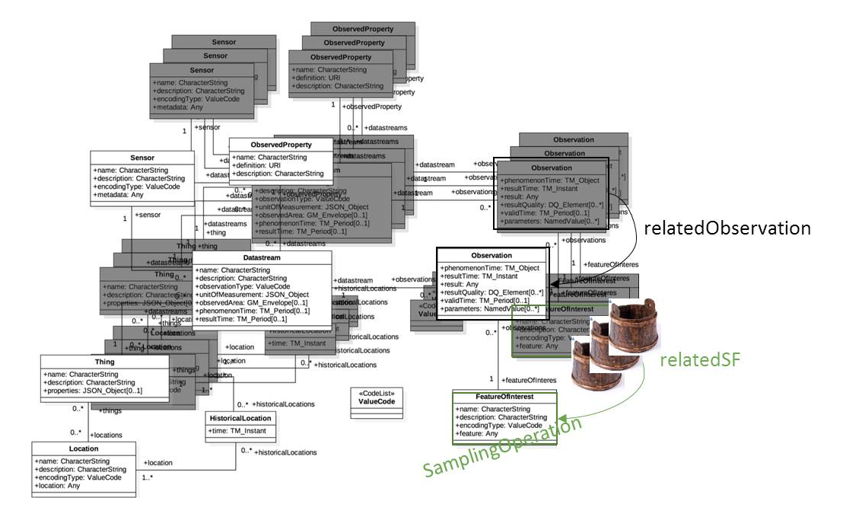
A vision – some more details
Introducing environmental conditions (ex : weather when sampling, …)
Analysis
White : one environmental condition
datastream (at a given station, …)
Black three quality datastreams (at a
given station, obsProperty, procedure)

Slide 10

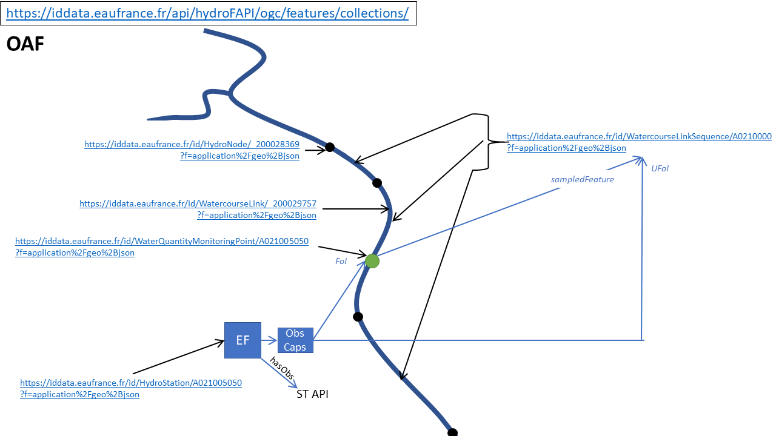

A vision – API Crosswalk
OAF : example using INSPIRE semantics the idea covers also HY_Features, OMS concepts
SensorThings API
Analysis
Analysis

Slide 11
What do we expect from the IE
Re the charter: Use case -> semantics -> APIs + URIs -> clients -> POC -> Best Practice doc
Semantics
UML > GML &| GeoJSON world => Necessary schemas (XSD & JSON-Schemas) on OMS, HY_Features, GWML2
WebSem world
Necessary terms in OGC Def server
Push OMS evolutions -> SSN/SOSA
Shared WQ vocabularies examples in I-ADOPT
LinkedData
Shared URIs pattern to identify water features
connegP behavior, WQ Linked Data & crawlers
Analysis

Slide 12
What do we expect from the IE
APIs & implementations
OGC API – Features -> Geoserver
Have generic ‘data templates’ stemming from the IE ER for broader reuse
Enhance connegP (different representation of the same, ex : GW_Aquifer)
OGC SensorThings API -> FROST
Have SensorThings API Part1 -> V2 : Sensing take into account elements from OMS (ex : Sample, ObservationCollection) + their serializations (GeoJSON, JSON-LD).
Analysis

Slide 13
What do we expect from the IE
Client
Demo that we can ingest data exposed according to the WQ IE findings in clients
Web: inspired from (S)ELFIE work
Surface-ground water networks interaction Demo
Ground water monitoring Demo
Desktop like QGIS
Recent QGIS ST API Plugin
Meeting previous work on QGIS GMLAS Toolbox (this work on the GML paradigm should be ported to the *JSON* ‘family’)
? Jupyter Notebook ?
Analysis

Slide 14
Contribution to the WQ IE
Access to
French Surface Water quality bank
French Ground Water quality bank
+ national data models (ST Sandre)
+ national Water Quality experts
OMS / OGC experts
Semantic web experts
Deployment of OGC API – Features and OGC SensorThings API on top of the 2 banks
WQ vocabs and linked data registries
Fund evolutions in some tools (ex: Geoserver, FROST, QGIS)
Analysis

Slide 15
Some previous presentations on the topic
Almost all on hydroDWG twiki (https://external.ogc.org/twiki_public/)
WQ Workshop 2022: Water quality data in practice: France and EU insight
OGC MM December 2021: 2021_ST_API_Hydro_Grellet.pptx
HydroDWG seminar on Water Quality data : https://external.ogc.org/twiki_public/pub/HydrologyDWG/HydroDWGSeminarMarch2021/20210317_WQ_INSIDE_BRGM_Grellet.pptx
Analysis

Slide 16
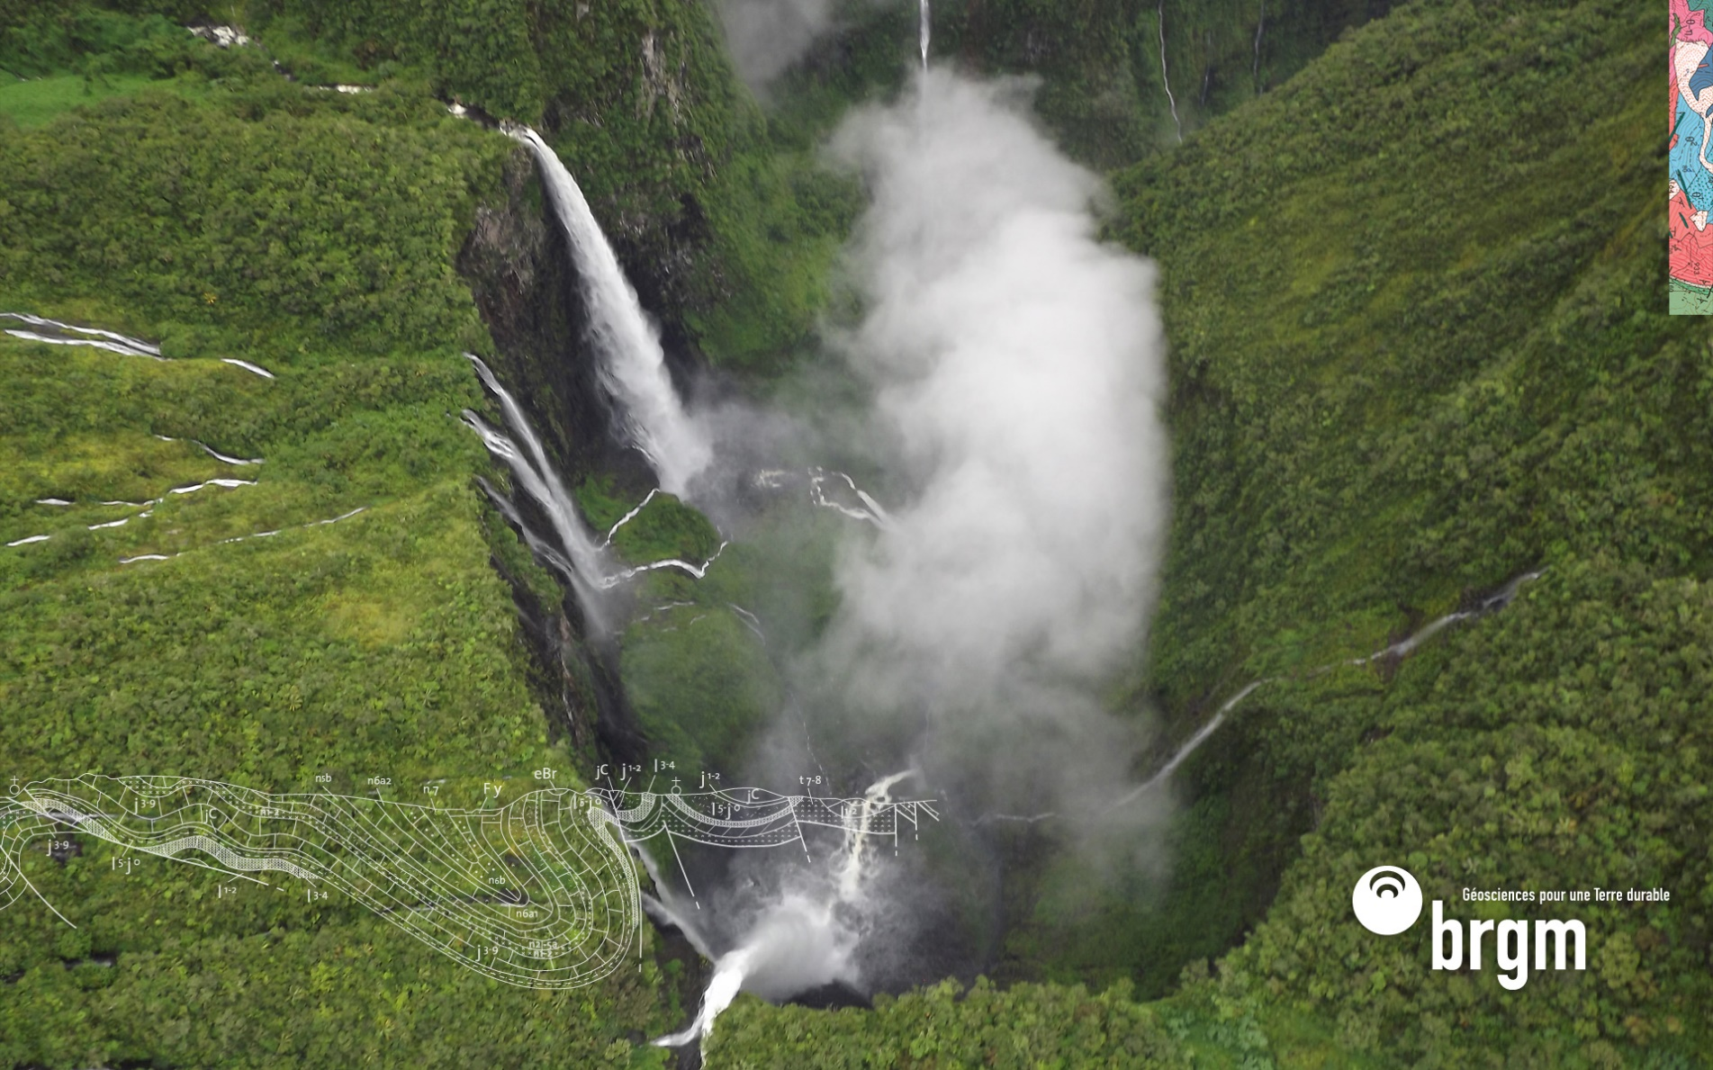
Thank you
s.grellet@brgm.fr

